Slide 1
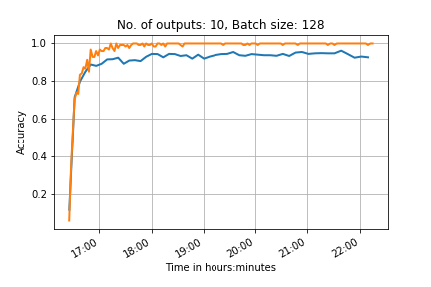
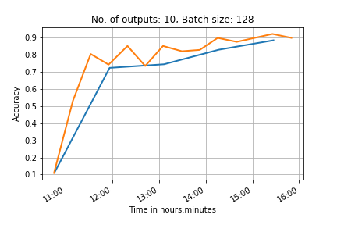
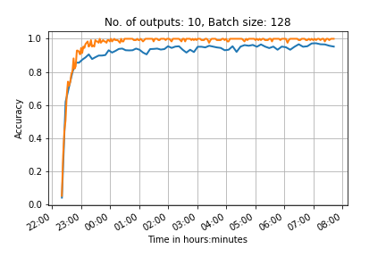
4 convolution layers
2 convolution layers, many outputs on each one
10 outputs
6 convolution layers

Slide 2
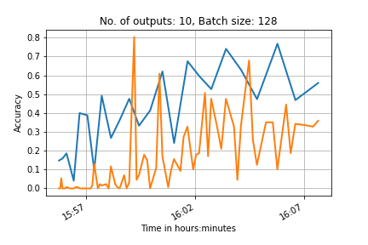
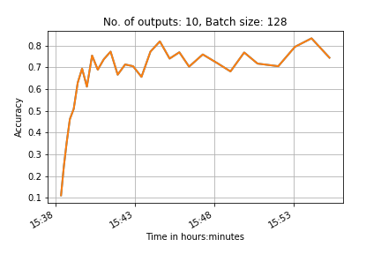
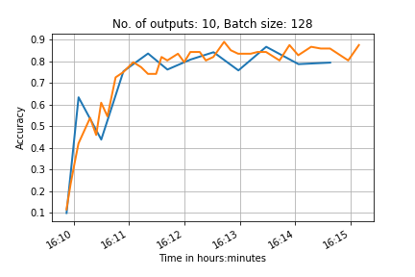
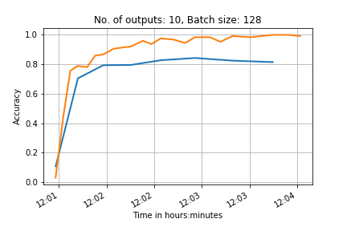
No shuffling
With shuffling
10 outputs,
Simple network
Normalised data
Advanced normalisation (and shuffled test data)

Slide 3
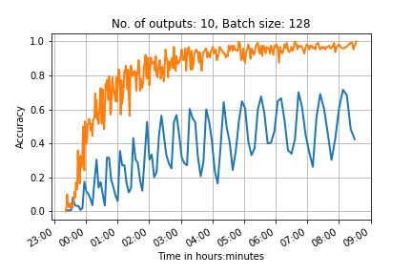
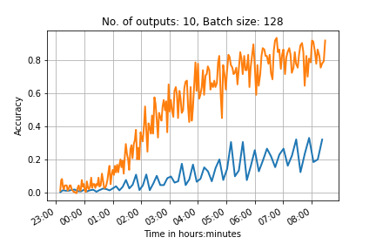
100 outputs
2 convolutional network, test batch 500
6 convolutional network test batch 1000
0.95(*10000) steps
0.65(*10000) steps
Learning rate too high?
Increase the drop out layer to prevent overfitting to the training data?
If we compare this to the previous network we expect it to have a testing accuracy of ~0.5 when it ends

Slide 4
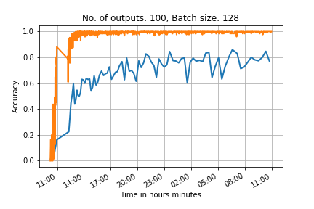
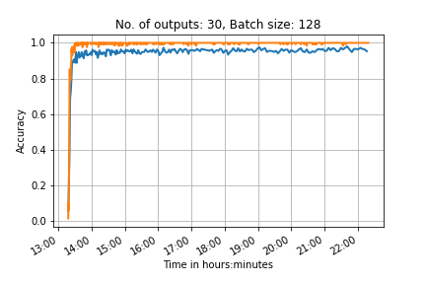
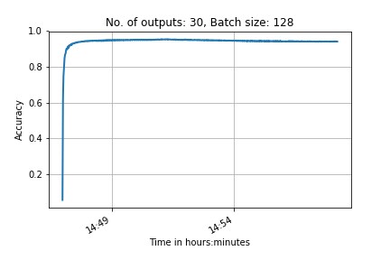
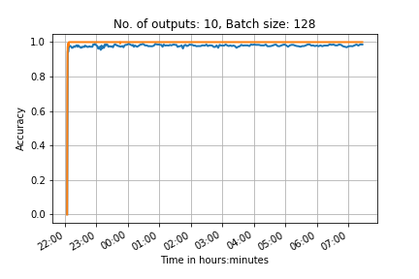
PRINT
CNN with 2 Convolutional layers and 2 fully connected layers
Transfer

Slide 5
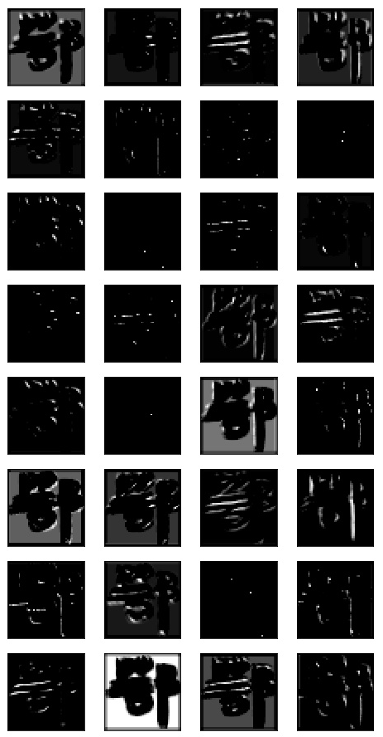
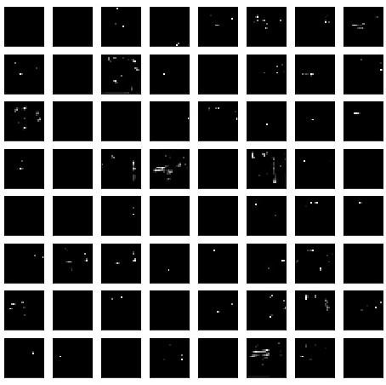
1st layer activations
2nd layer activations
Feature maps from convolutional layers from network trained on 100 classes from scratch
PRINT

Slide 6
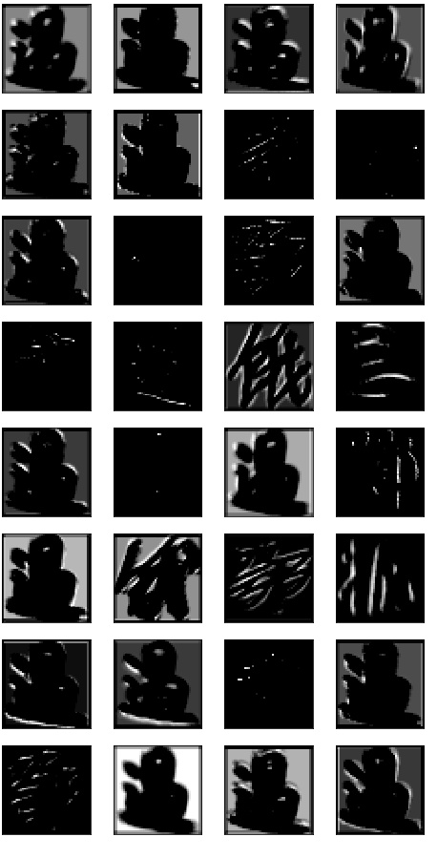
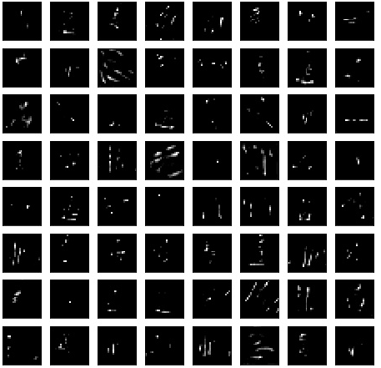
Feature maps – maximum activation
1st layer activations
2nd layer activations
Feature maps from convolutional layers from network trained on 100 classes from scratch

Slide 7
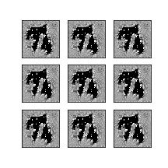
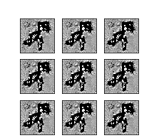
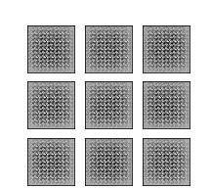
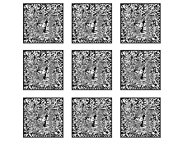
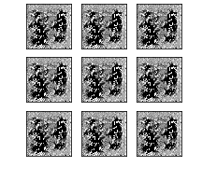
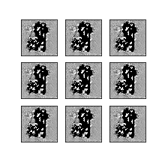
GAN

Slide 8
References
Feature maps
https://arxiv.org/pdf/1507.02313.pdf
Transfer learning
https://papers.nips.cc/paper/5347-how-transferable-are-features-in-deep-neural-networks.pdf
Notes on online deep learning course
https://arxiv.org/pdf/1507.02313.pdf
GANs:
Overview of GANs: https://arxiv.org/pdf/1710.07035.pdf
Face aging with cGAN: https://arxiv.org/pdf/1702.01983.pdf
Image de-raining with cGAN: https://arxiv.org/pdf/1701.05957.pdf
Original GAN paper: http://papers.nips.cc/paper/5423-generative-adversarial-nets.pdf
DC-GAN paper: https://arxiv.org/pdf/1511.06434.pdf
ALI (Adversarially learned inference) model: https://arxiv.org/pdf/1606.00704.pdf
BiGAN (same as ALI): https://arxiv.org/pdf/1605.09782.pdf

Slide 9
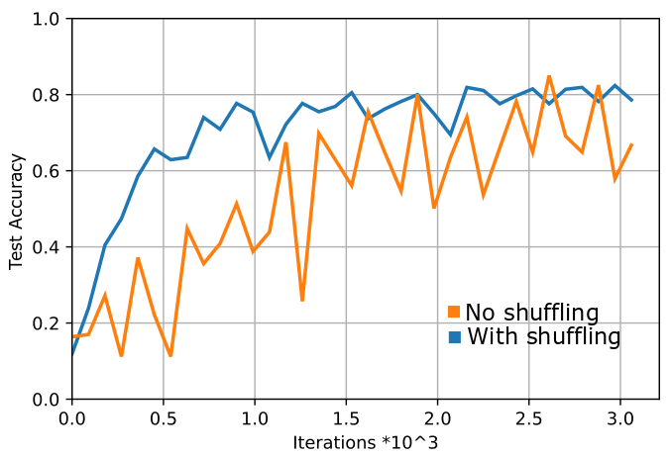
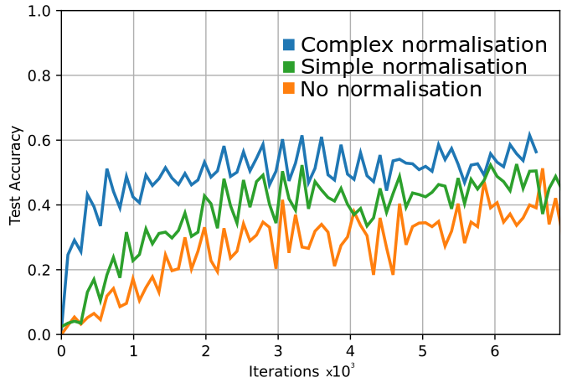
30 outputs, 128 train batch size, LR 1e-3, test batch 500
100 outputs, 128 train batch size, LR 1e-3, test batch 500
Simple norm (-0.5 to 0.5)
Complex norm (mean and standard deviation)

Slide 10
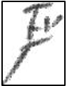
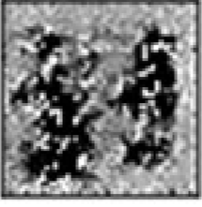
Feed in array of random numbers
[0, 0.3, 0.6, ... , 0.1, 0]
Feed in real image
Feed in fake image
Discriminator for real images
Discriminator for fake images
Generator for fake images
Discriminators share weights
Real discriminator loss
Generator loss
Fake discriminator loss
Total discriminator loss
‘real’ label
‘fake’ label

Slide 11
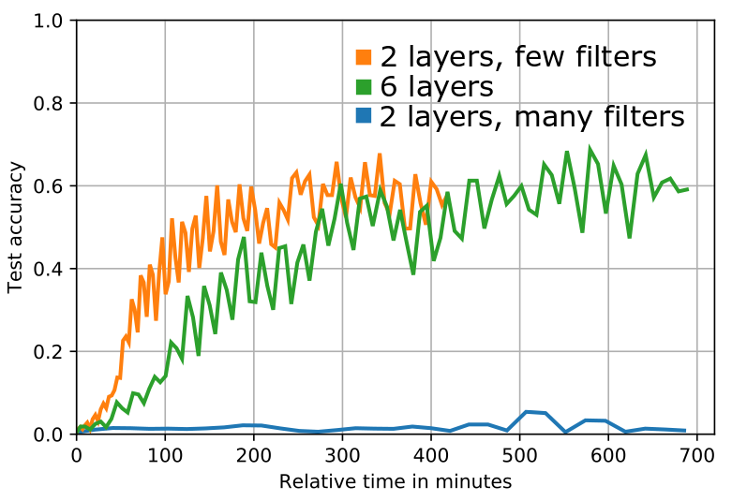
100 outputs, 128 train batch size, LR 1e-3, test batch 500.
2conv: 32, 64 filters
2 conv many filters: 128, 256 filters
6 conv: 32, 64, 96, 128, 160, 196

Slide 12
real image
array of N random numbers
[0, 0.3, 0.6, ... , 0.1, 0]
Generator for fake images
Encoder for real images
Discriminator for real images
Discriminator for fake images
[0, 0.3, 0.6, ... , 0.1, 0]
Length N encoding of image
Fake Image predictions
‘real’ Image predictions
Generated fake image
Generator loss
Discriminator loss (real images)
discriminator loss (fake images)
Although labelled separately, the generator loss and encoder loss contribute to a total encoder/generator loss
the discriminator loss for both fake and real images contributes to the total discriminator loss.
Encoder loss
‘real’ label
‘fake’ label

Slide 13
Encoder
5 convolutions
[0.9, 0.2, ..., 0, 0.6]
Generated encoding
Real image
Array, image pair
5 convolutions
Real/fake
[0, 0.3, ..., 0.1, 0]
5 deconvolutions
Discriminator
Array of random numbers
Generated fake image
Generator

Slide 14
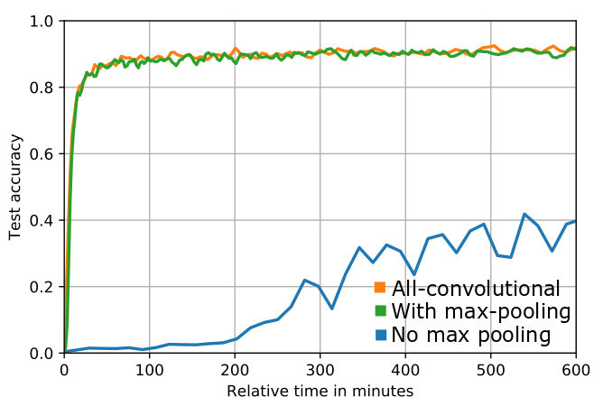
100 outputs, 128 batch size, 1e-3 LR
2-conv: 32, 64 filters (with and without max pooling)
All-conv: 32, 32, 64, 64 (no max pooling)

Slide 15












Slide 16
Bottleneck layer

